Slide 1
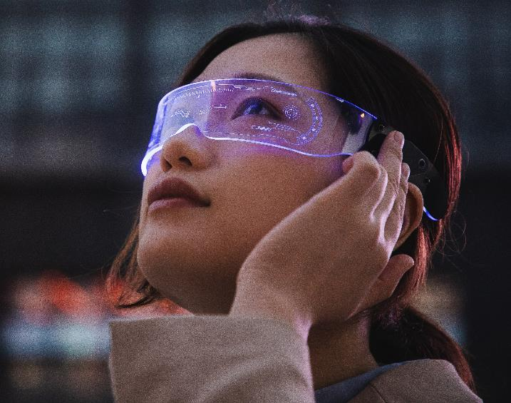
DEEP FAKE DETECTION
PRESENTATION ON:

Slide 2
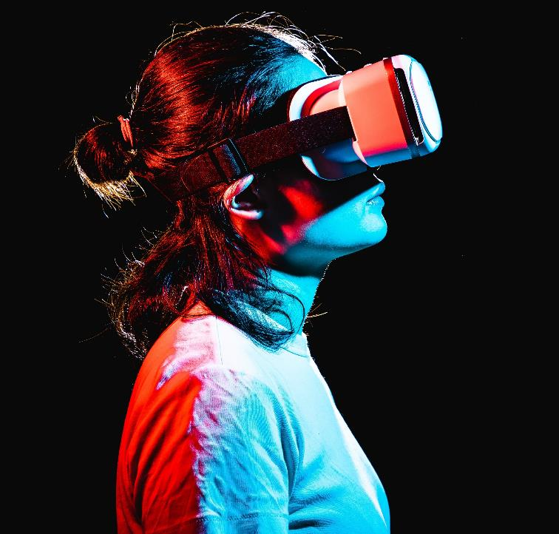
WHAT IS DEEP FAKE?
Deepfake is a technique for human image synthesis based on artificial intelligence. It is used to combine and superimpose existing images and videos onto source images or videos using a machine learning technique known as generative adversarial networks. Deepfake technology has been used to create realistic-looking videos of people, such as politicians, celebrities, or other public figures, saying or doing things that they never actually said or did. It can also be used to create convincing fake news stories or to alter existing video content.

Slide 3
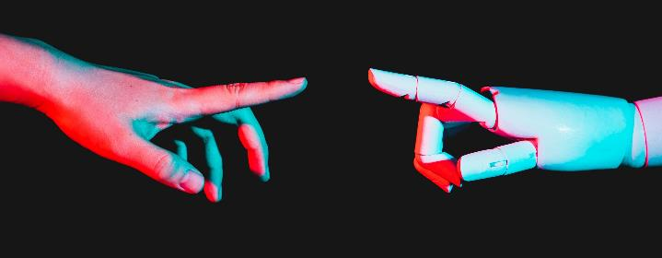
ABOUT PROJECT
Deepfake detection project using vision transformer and neural network is a cutting-edge technology that aims to detect and prevent the spread of deepfake images. A deepfake is a type of synthetic media in which a person's face or voice is replaced with someone else's, creating the illusion of a real face.
Though Deep fake is very difficult to be detected but the use of combination of VISION TRANSFORMER and NEURAL NETWORK technologies to analyze the image and detect any signs of manipulation. The vision transformer (VIT) is a deep learning model that can analyze images at a high resolution, while the neural network is used to classify and identify any anomalies in the images.
The deepfake detection AI model project starts by analyzing the image pixel by pixel, looking for any signs of manipulation such as unnatural spots, changes in facial colors, or inconsistencies in lighting and shadows. The model then uses the neural network to classify the image as either real or fake.
One of the key advantages of using a VISION TRANSFORMER and NEURAL NETWORK for deepfake detection is that it can analyze image at a much higher resolution than traditional methods. This means that the model can detect even subtle changes in the images, making it much more effective at detecting deepfakes.
Overall, the deepfake detection AI model project using vision transformer and neural network is an important step towards preventing the spread of deepfake videos and ensuring the authenticity of online content.

Slide 4
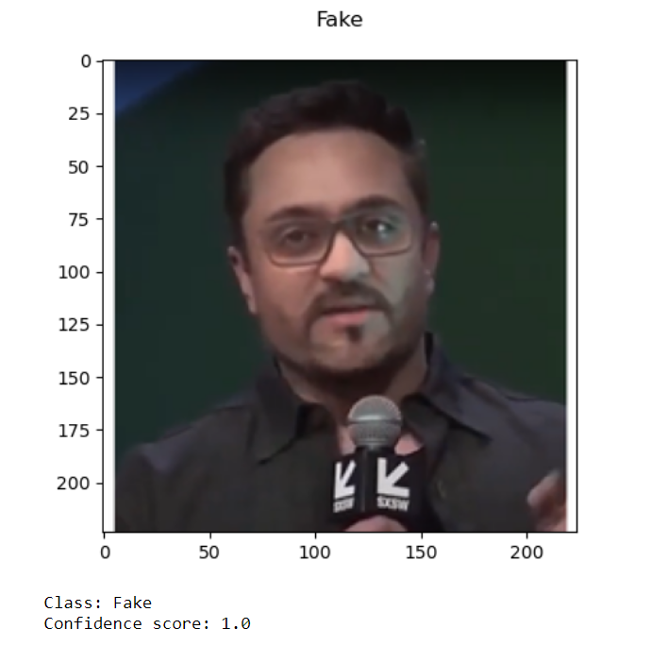
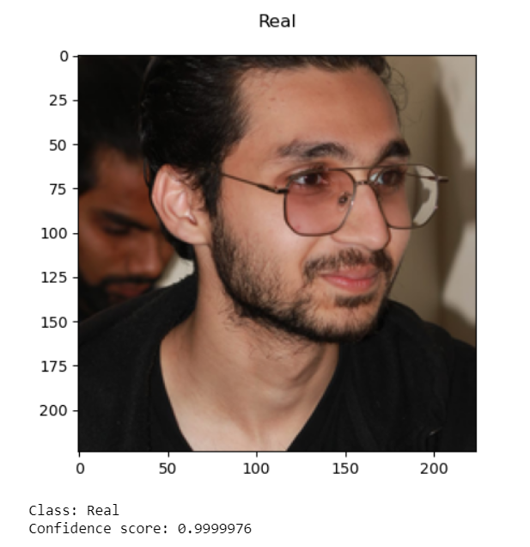
APPLICATION OF DEEP FAKE
OUTPUT
Deepfake detection AI models can be used in a variety of applications, including:
Media and entertainment: Identifying and removing deepfake videos by capturing frames from the video from social media platforms and online content sharing sites.
Law enforcement: Detecting and investigating deepfake images used for criminal activities, such as identity theft, extortion, and fraud.
Politics: Identifying and counteracting deepfake videos used to spread disinformation and manipulate public opinion during elections.
Business: Identifying deepfake videos used to impersonate executives or other individuals in order to fraudulently obtain sensitive information or financial gain.
Security: Detecting deepfake videos used to impersonate government officials or military personnel in order to gain access to sensitive information or resources.
This is the deep fake image superimposed on Elon musk’s face and our program efficiently analysis that it is FAKE
And this is the image of me which is absolutely REAL

Slide 5
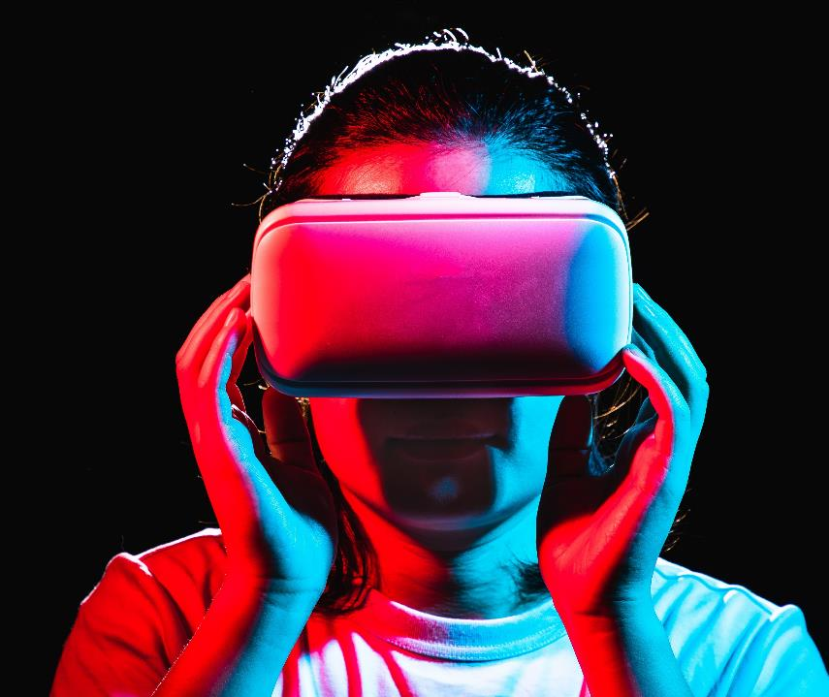
Thank you
By:
MUHAMMAD ASHARIB REHAN
(B21F0219AI023)

